Slide 1
Software Design and Architecture
Pattern Focus Design: A Case Study

Slide 2
Duck Simulator
We are to build a new Duck Simulator with the requirements
Ducks are the focus, but other water fowl (e.g. Geese) can join in too
Need to keep track of how many times duck’s quack
Control duck creation such that all other requirements are met
Allow ducks to band together into flocks and subflocks
Generate a notification when a duck quacks

Slide 3
Duck Simulator
To avoid coding to an implementation, create a “Quackable”
Interface and replace all instances of “duck” above with the word “Quackable”.

Slide 4
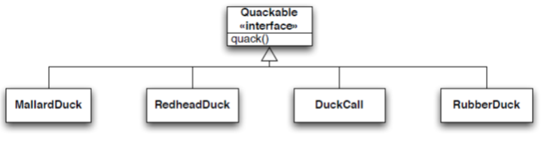
Step 1: Need an Interface
All simulator participants will implement this interface

Slide 5
Duck Simulator
We are to build a new Duck Simulator with the requirements
Ducks are the focus, but other water fowl (e.g. Geese) can join in too
Need to keep track of how many times duck’s quack
Control duck creation such that all other requirements are met
Allow ducks to band together into flocks and subflocks
Generate a notification when a duck quacks

Slide 6
Opportunities for Patterns
Requirements:
Ducks are the focus, but other water fowl (e.g. Geese) can join in too
Need to keep track of how many times duck’s quack
Control duck creation such that all other requirements are met
Allow ducks to band together into flocks and subflocks
Generate a notification when a duck quacks

Slide 7
Opportunities for Patterns
Requirements:
Ducks are the focus, but other water fowl (e.g. Geese) can join in too (ADAPTER)
Need to keep track of how many times duck’s quack
Control duck creation such that all other requirements are met
Allow ducks to band together into flocks and subflocks
Generate a notification when a duck quacks

Slide 8
Step 2: Need Participants

Slide 9
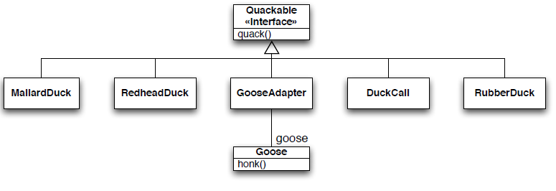
Step 3: Need Adapter
All participants are now Quackables, allowing us to treat them uniformly

Slide 10
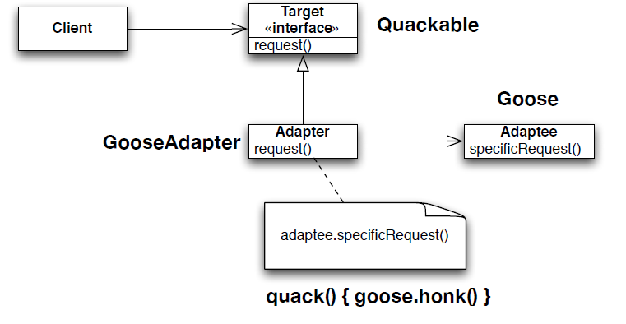
Review: (Object) Adapter Structure

Slide 11
Opportunities for Patterns
Requirements:
Ducks are the focus, but other water fowl (e.g. Geese) can join in too (ADAPTER)
Need to keep track of how many times duck’s quack
Control duck creation such that all other requirements are met
Allow ducks to band together into flocks and subflocks
Generate a notification when a duck quacks

Slide 12
Opportunities for Patterns
Requirements:
Ducks are the focus, but other water fowl (e.g. Geese) can join in too (ADAPTER)
Need to keep track of how many times duck’s quack (DECORATOR)
Control duck creation such that all other requirements are met
Allow ducks to band together into flocks and subflocks
Generate a notification when a duck quacks

Slide 13
Step 4: Use Decorator to Add Quack Counting
Note: two relationships between QuackCounter and Quackable
Previous classes/relationships are all still there… just elided for clarity

Slide 14
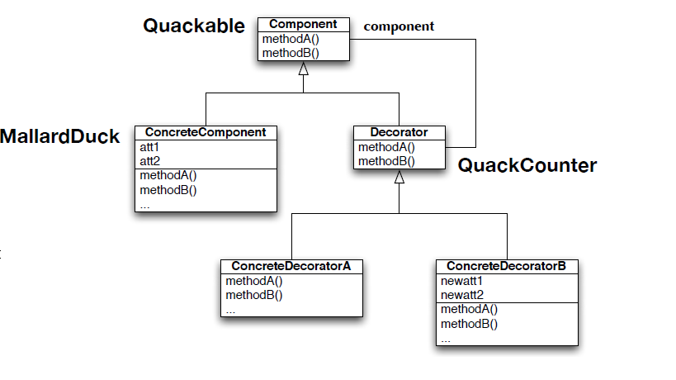
Review: Decorator Structure
No need for an abstract Decorator interface in this
situation; note that QuackCounter follows ConcreteDecorators, as it adds state and methods on top of the original interface.

Slide 15
Opportunities for Patterns
Requirements:
Ducks are the focus, but other water fowl (e.g. Geese) can join in too (ADAPTER)
Need to keep track of how many times duck’s quack (DECORATOR)
Control duck creation such that all other requirements are met (FACTORY)
Allow ducks to band together into flocks and subflocks
Generate a notification when a duck quacks

Slide 16
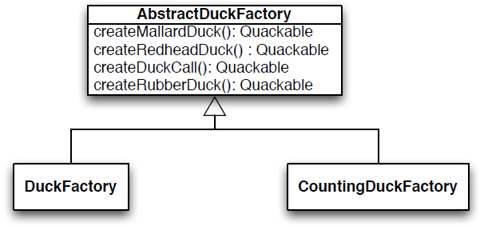
Step 5: Add Factory to Control Duck Creation
CountingDuckFactory returns ducks that are automatically wrapped by the QuackCounter developed in Step 4
This code is used by a method in DuckSimulator that accepts an instance of AbstractDuckFactory as a parameter.

Slide 17
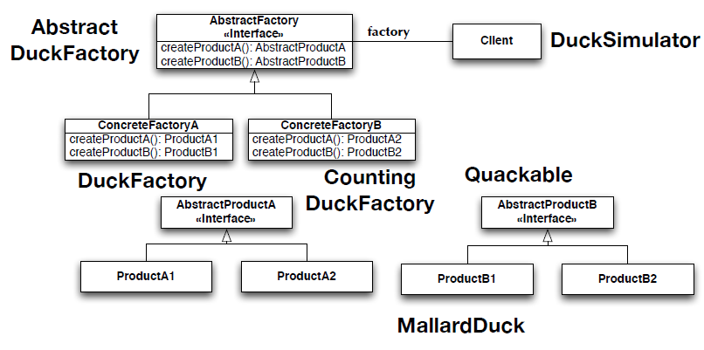
Review: Abstract Factory Structure

Slide 18
Opportunities for Patterns
Requirements:
Ducks are the focus, but other water fowl (e.g. Geese) can join in too (ADAPTER)
Need to keep track of how many times duck’s quack (DECORATOR)
Control duck creation such that all other requirements are met (FACTORY)
Allow ducks to band together into flocks and subflocks
Generate a notification when a duck quacks

Slide 19
Opportunities for Patterns
Requirements:
Ducks are the focus, but other water fowl (e.g. Geese) can join in too (ADAPTER)
Need to keep track of how many times duck’s quack (DECORATOR)
Control duck creation such that all other requirements are met (FACTORY)
Allow ducks to band together into flocks and subflocks (COMPOSITE and ITERATOR)
Generate a notification when a duck quacks

Slide 20
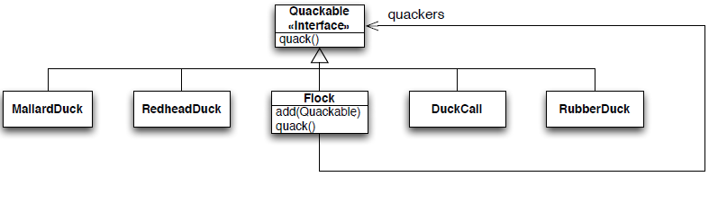
Step 6: Add support for Flocks with Composite
Note: Iterator pattern is hiding inside of Flock.quack();
Note: This is a variation on Composite, in which the Leaf and Composite classes have different interfaces;
Only Flock has the “add(Quackable)” method.
Client code has to distinguish between Flocks and Quackables as a result. Resulting code is “safer” but less transparent.

Slide 21
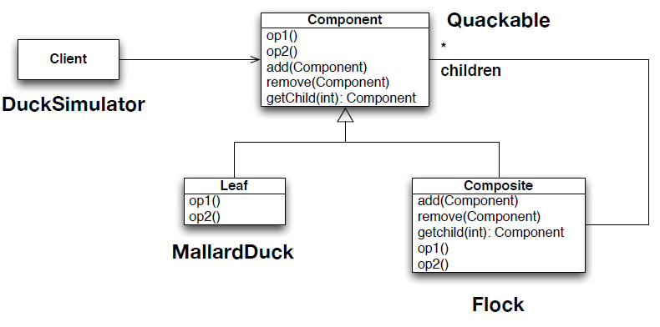
Review: Composite Structure

Slide 22
Opportunities for Patterns
Requirements:
Ducks are the focus, but other water fowl (e.g. Geese) can join in too (ADAPTER)
Need to keep track of how many times duck’s quack (DECORATOR)
Control duck creation such that all other requirements are met (FACTORY)
Allow ducks to band together into flocks and subflocks (COMPOSITE and ITERATOR)
Generate a notification when a duck quacks

Slide 23
Opportunities for Patterns
Requirements:
Ducks are the focus, but other water fowl (e.g. Geese) can join in too (ADAPTER)
Need to keep track of how many times duck’s quack (DECORATOR)
Control duck creation such that all other requirements are met (FACTORY)
Allow ducks to band together into flocks and subflocks (COMPOSITE and ITERATOR)
Generate a notification when a duck quacks (Observer)

Slide 24
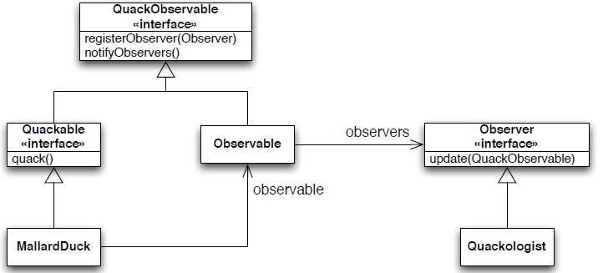
Step 7: Add Quack Notification via Observer
Cool implementation of the Observer pattern. All Quackables are made Subjects by having Quackable inherit from QuackObservable. To avoid duplication of code, an Observable helper class is implemented and composed with each ConcreteQuackable class. Flock does not make use of the Observable helper class directly; instead it delegates those calls down to its leaf nodes.

Slide 25
Review: Observer Structure

Slide 26
Counting Roles
As you can see, a single class will play multiple roles in a design
Quackable defines the shared interface for five of the patterns
Each Quackable implementation has four roles to play: Leaf, ConcreteSubject, ConcreteComponent, ConcreteProduct

Slide 27
Counting Roles
You should now see why names do not matter in patterns
Imagine giving MallardDuck the following name: MallardDuckLeafConcreteSubjectComponentProduct
Instead, it’s the structure of the relationships between classes and the behaviors implemented in their methods that make a pattern REAL
And when these patterns live in your code, they provide multiple extension points throughout your design. Need a new product, no problem. Need a new observer, no problem. Need a new dynamic behavior, no problem.

